Slide 1

DEEP LEARNING-BASED AUTOMATIC MUSIC TRANSCRIPTION USING CR-GCN
By
126003238 Selvakarthik S 126003241 Shanthosh Kumar R 126003218 Rithvik L
Project Guide – Dr. Emily Jenifer A

Slide 2
MOTIVATION
Music is a major stress-buster for billions around the world. While we listen to millions of songs each year, certain tunes stay with us in our minds.
Musicians often transcribe these melodies into music sheets to aid in composition and performance.
Our goal is to convert a piece of music into its corresponding notes using a CR-GCN model.
To make this process accessible to everyone, we plan to develop a web application where users can upload a music file, and our model will generate the corresponding music notes, which will be displayed as a music sheet within the application.

Slide 3
OBJECTIVE
To develop an approach to convert an audio file (music) into its corresponding musical notes.
To identify and leverage efficient feature selection algorithms.
To select and utilise suitable classification algorithms.
To construct a model with the highest possible accuracy through rigorous training and testing on large datasets.
To deploy the model as a back-end in an user-friendly web application.

Slide 4
BASE PAPER
[1] Xiao, Z., Chen, X., & Zhou, L. (2023). Polyphonic piano transcription based on graph convolutional network. Signal Processing, 212, 109134.
Doi : https://doi.org/10.1016/j.sigpro.2023.109134

Slide 5
To design an Automatic Music Transcription (AMT) system that accurately converts complex polyphonic audio signals into symbolic music representations by capturing note interdependencies and temporal dynamics.
To deploy the model as a back-end in an user-friendly web application.
PROBLEM STATEMENT

Slide 6
ABSTRACT
The task of automatic music transcription (AMT) mainly focuses on converting audio signals to symbolic music representations, facilitating applications such as computational musicology and music analysis.
One of the biggest problems is when multiple notes are played at the same time, dimension explosion can happen which makes it difficult for accurate music note transcription.
To overcome this challenge, we have proposed a hybrid deep learning architecture combining Convolutional Neural Network for spatial feature extraction, bidirectional LSTMs or self-attention mechanisms for precise temporal note-level predictions and Graph Convolutional Network for accurate label learning to capture note interdependencies in polyphonic music.
Experiments on public datasets like MAESTRO, MAPS, GiantMIDI show that the proposed methodology with F1-score of 96.88% is much more superior than existing methodologies like Onset and Frames, Wavenet, Non-Negative Matrix Factorization (NMF).
The generated music sheets validate the model’s accuracy and practical applicability, providing a valuable tool for musicians and researchers.
By addressing the limitations of prior methods, the proposed approach CR-GCN (Channel Relationship-Based Graph Convolutional Network) represents a step forward in automated transcription technology, making it feasible for large-scale and real-time applications.

Slide 7
LITERATURE SURVEY
TITLE | MERITS | DEMERITS
A Data-Driven Analysis of Robust Automatic Piano Transcription | The study improved note-onset accuracy to 88.4 F1-score on the MAPS dataset through data augmentation. | Performance on out-of-distribution annotated piano data indicates challenges in generalizing to unseen data.
Automatic Piano Sheet Music Transcription with Machine Learning | BiLSTM architecture is identified as one of the effective for automatic piano music transcription, achieving a top F1-score of 74.80%. | CNNs underperform significantly in music transcription tasks, achieving only an F1-score of 22.85% despite extensive hyper-parameter tuning.
Research on the Recognition of Piano-Playing Notes by a Music Transcription Algorithm | The CRNN algorithm combines CNN and BiLSTM, achieving impressive F1-scores of 84.90%, 92.24%, and 79.27% for frames, notes, and offsets. | The study's results have limited generalizability due to small datatset, with further exploration of different piano note features needed to enhance recognition accuracy.
Multimodal Image and Audio Music Transcription | The multimodal framework combining OMR and AMT improves transcription accuracy by reducing errors up to 40% for more accurate music transcription. | The proposed framework can degrade overall transcription accuracy if either OMR or AMT already performs near-perfectly. Overall Transcription may degrade
Automatic Piano Music Transcription Using Audio-Visual Features | This research uses audio-visual features to improve piano music transcription accuracy by 12.69%, surpassing audio-only systems. | The system's dependency on specialized equipment, like an overhead camera, limits its practicality for general use

Slide 8
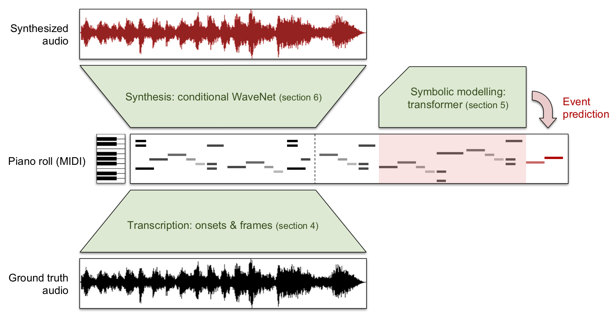
DATASET PREPARATION
Datasets Used:
The MAESTRO Dataset
MAESTRO (MIDI and Audio Edited for Synchronous TRacks and Organization) is a dataset composed of about 200 hours of virtuosic piano performances.
The audio files are captured with fine alignment (~3 ms) between note labels and audio waveforms.

Slide 9
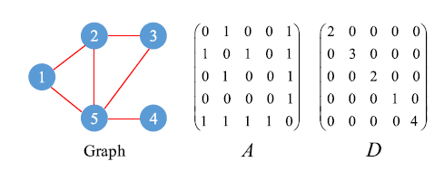
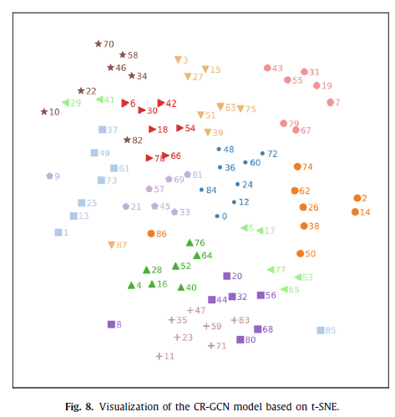
EXISTING SYSTEM
Key Features:
Combination of CNN, RNN, GCN
Two Stage Learning - Feature Learning and Label Learning
Graph Representation of Notes
Mapped Classifier with Dot Product
CR-GCN (Channel Relationship-Based Graph Convolutional Network)
CNN for spatial features, LSTM for temporal dependencies, and GCN for modeling relationships between notes in a graph-based format.
Performance:
Datasets & Accuracies:
MAESTRO (v2) : Precision - 97.38%, Recall - 96.21%, F1-Score - 96.88%
MAPS Dataset : Precision - 84.30%, Recall - 84.65%, F1-Score - 84.48%
Advantages:
Joint Feature and Label Learning
Scalable to Multi-Label Tasks
Improved Performance for Complex Music and Generalizable to Other Domains

Slide 10
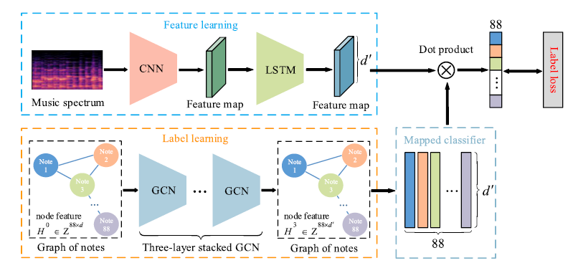
EXISTING SYSTEM

Slide 11
LIMITATIONS OF EXISTING SYSTEM
1. Graph Convolutional Networks (GCN)
Complexity : Requires a well-defined graph structure, which can be challenging to construct for audio data like polyphonic music.
Scalability Issues : As the number of notes or features increases, the graph size grows, leading to computational inefficiency.
Limited Temporal Modeling : GCNs are not inherently designed to capture temporal dependencies, which are crucial in music transcription.
2. Convolutional Neural Networks (CNN)
Lack of Temporal Context: CNNs excel at spatial feature extraction but struggle with capturing temporal dynamics in music, such as note transitions.
Overfitting Risk: With limited training data, CNNs can overfit, especially when dealing with complex polyphonic music.
Fixed Receptive Field: The fixed kernel size may miss long-range dependencies in music sequences.

Slide 12
LIMITATIONS OF EXISTING SYSTEM
3. Long Short-Term Memory Networks (LSTM)
Vanishing Gradient Problem: Despite being designed to handle long-term dependencies, LSTMs can still face challenges with very long sequences.
High Computational Cost: LSTMs are resource-intensive, making them slower to train compared to other models.
Sensitivity to Input Representation: The performance of LSTMs heavily depends on how the input (e.g., spectrograms or MIDI data) is preprocessed.
4. Some other Limitations
Data Dependence and Annotation Challenges
Model Interpretability and Debugging
Real-Time Processing and Computational Overhead

Slide 13
SPECIFICATIONS AND REQUIREMENTS
Hardware Requirements
Processor: A multi-core processor (e.g., Intel i5/i7 or AMD Ryzen 5/7) for efficient computation.
RAM: At least 8 GB (16 GB recommended) to handle large datasets and model training.
Storage: SSD with at least 256 GB for faster data access and storage of audio files, models, and results.
GPU: A dedicated GPU (e.g., NVIDIA GTX 1650 or higher) for training deep learning models.
Audio Interface: Optional, for high-quality audio input/output if you plan to work with live recordings.
Processor Used : Intel(R) Xeon(R) Silver 4310 CPU @ 2.10GHz
GPU Used : NVIDIA A100 Tensor Core GPU

Slide 14
SPECIFICATIONS AND REQUIREMENTS
Software Requirements
Programming Language: Python (widely used for machine learning and audio processing).
Libraries/Frameworks:
TensorFlow or PyTorch: For building and training neural networks.
Librosa: For audio analysis and feature extraction.
Music21: For music theory and symbolic music processing.
MIDI Libraries: Such as mido or pretty_midi for handling MIDI files.
pdf2image: To make images of Music Sheets from pdf format.
lilypond: To make pdf of Music Sheets from the MIDI notes.
numpy: Used for scientific and numerical computing like arrays , matrices , data analysis.
Audio Tools:
Audacity: For audio editing and preprocessing.
FFmpeg: For audio format conversion.
Operating System: Windows, macOS, or Linux (Linux is often preferred for machine learning projects).
IDE/Code Editor: Visual Studio Code, Jupyter Notebook, or PyCharm for coding and debugging.

Slide 15
MODULE
MODULE 1: DATA PREPROCESSING AND DATA SPLITTING
MODULE 2: FEATURE LEARNING USING CNN + LSTM
MODULE 3: LABEL LEARNING USING GCN
MODULE 4: RESULTS AND OBSERVATION (so far)
MODULE 5: DEPLOYMENT

Slide 16
MODULE 1: DATA PREPROCESSING
As per the dataset we have incorporated into our project (Maestro v3), the categorical X attribute consists of .wav audio files.
To enhance performance of our model, it is required to convert the .wav files into its corresponding mel-spectrograms which is achieved using the librosa module of python.
A mel spectrogram is a visual representation of an audio signal's frequency content over time, using the mel scale on the y-axis and decibel scale for amplitude, making it more aligned with human auditory perception.
The mel-spectrogram consists of the frequency (in hz) in y-axis and time in x-axis (in s) and also the sound-level (in db) is depicted as a third parameter with variation in colors.
Mel spectrograms provide an estimate of the short-term, time-localized frequency content of an audio signal, making them useful for analyzing how audio patterns change over short intervals of time.

Slide 17
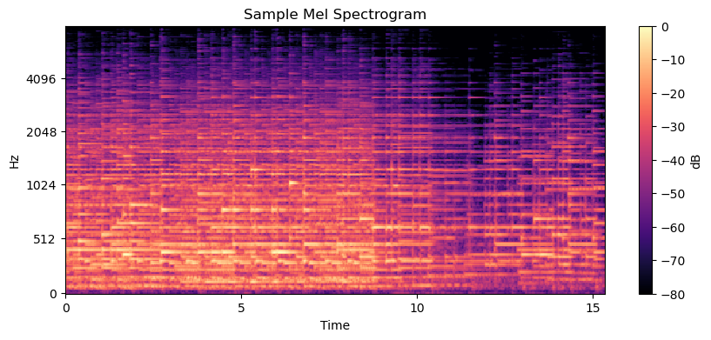

Slide 18
MODULE 1: DATA PREPROCESSING
As per the dataset we have incorporated into our project (Maestro v3), the categorical Y attribute consists of .midi files.
To enhance performance of our model, it is required to convert the .midi files into its corresponding piano rolls which is achieved using the pretty_midi module of python.
A piano roll is a visual representation of musical notes over time, where notes are depicted as horizontal lines or bars on a grid, with the vertical axis representing pitch and the horizontal axis representing time.
The piano roll consists of the midi notes (from 21-108) in y-axis and time in x-axis (in s) and also whether the note is pressed or not is depicted as a third parameter with variation in hues.
Piano rolls can also convey additional information such as note duration and velocity, which can be represented through variations in line length and color intensity, respectively, providing a comprehensive view of musical performance dynamics.

Slide 19
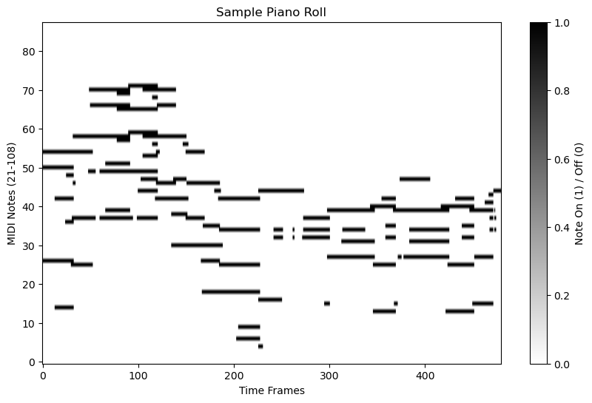

Slide 20
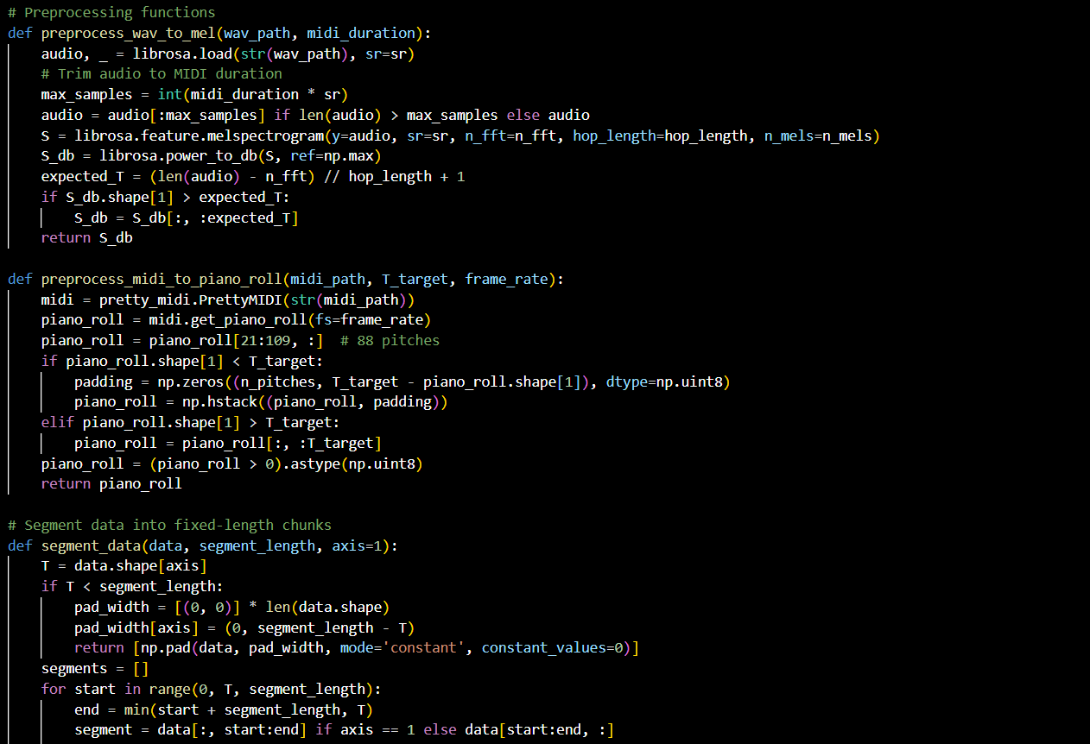
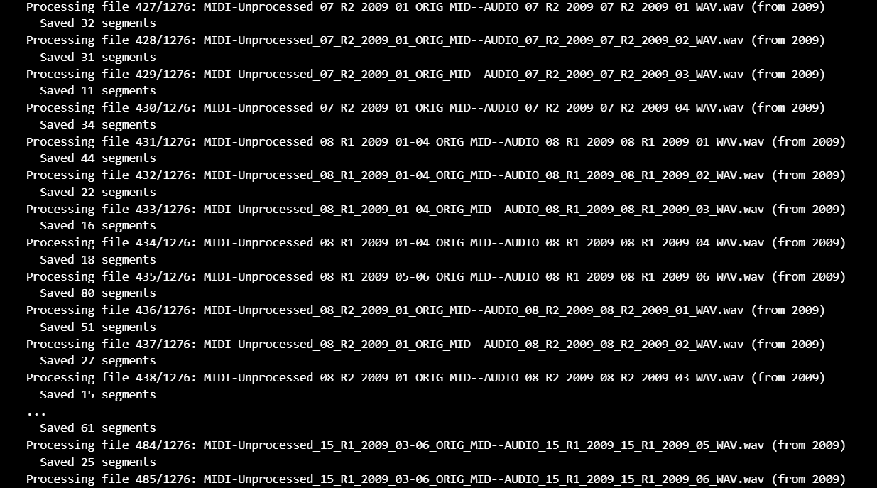
MODULE 1: DATA PREPROCESSING
Output:

Slide 21
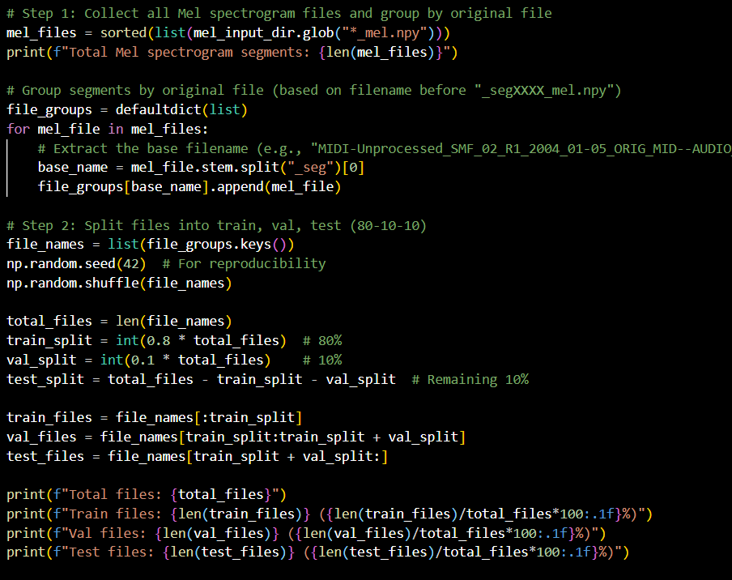
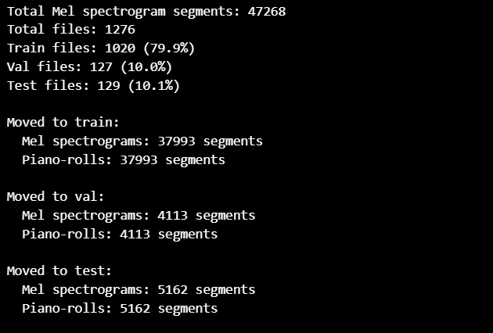
MODULE 1: DATA SPLITTING
Output:

Slide 22
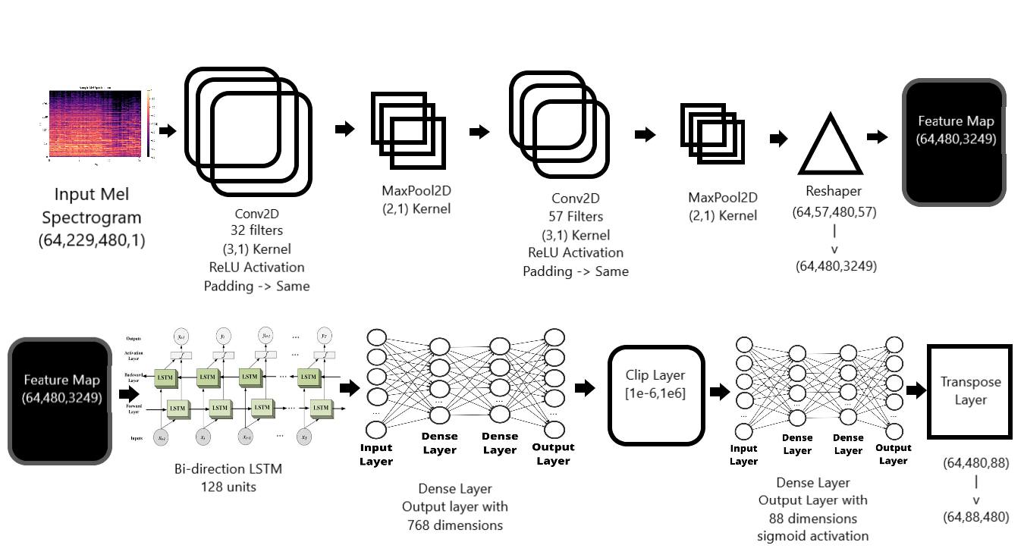
MODULE 2: FEATURE LEARNING CNN + LSTM

Slide 23
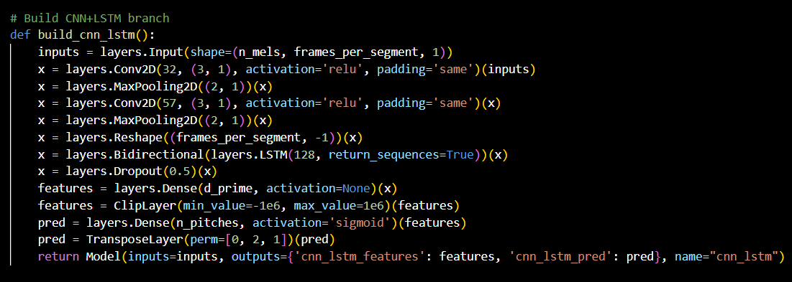
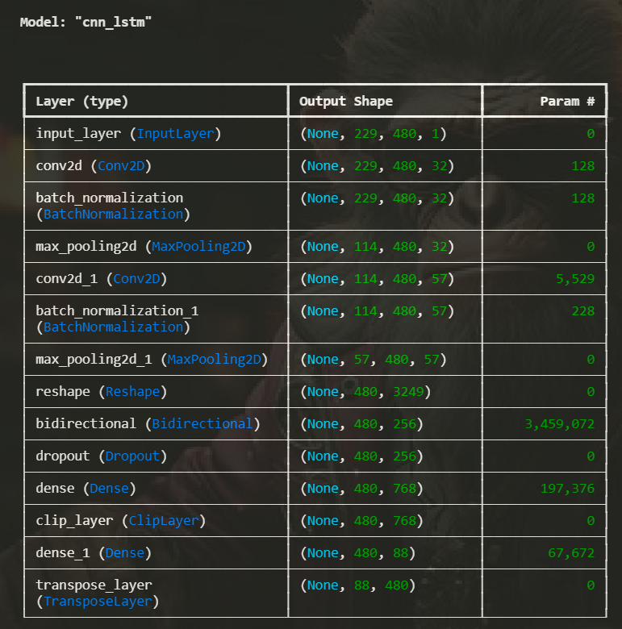
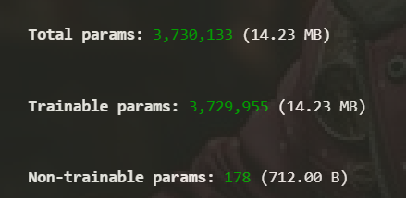
MODULE 2: FEATURE LEARNING CNN + LSTM
Output:

Slide 24
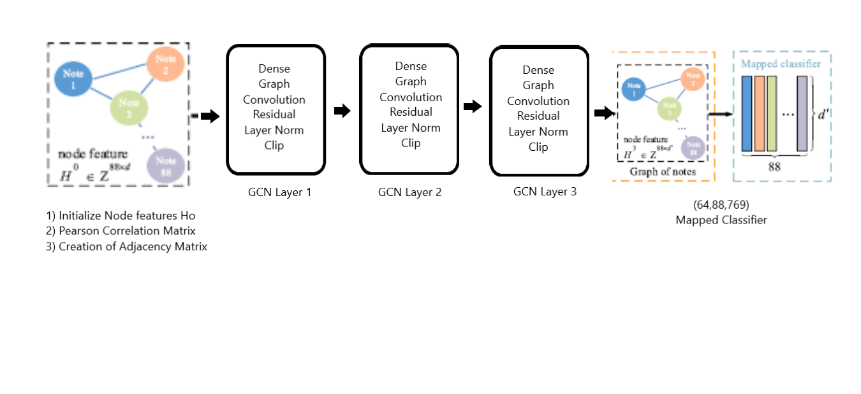
MODULE 3: LABEL LEARNING USING GCN
Feature Concatenation:
Dot product of feature map from CNN + LSTM and Mapped Classifier from GCN to compute Label loss and train our model

Slide 25
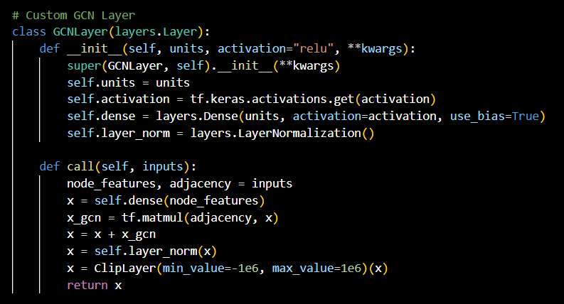
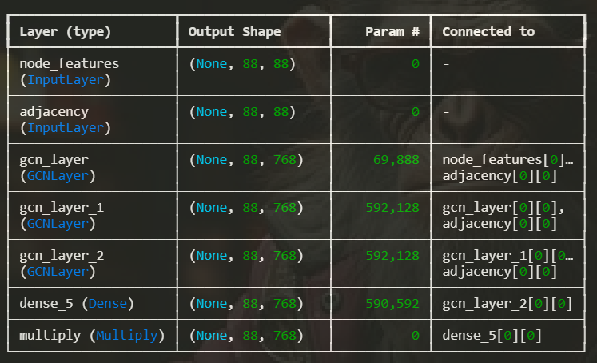
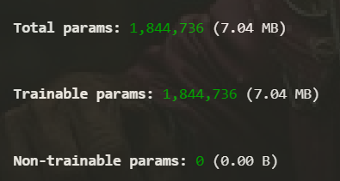
MODULE 3: LABEL LEARNING USING GCN
Output:

Slide 26
MODULE 4: RESULTS
The training journey for the CR-GCN model involved multiple iterations, starting with data preprocessing, facing errors like GCN gradient issues, and refining the model to achieve a final frame-level F1 score of 0.19.
Initial challenges included GCN gradients not flowing, addressed by adjusting the adjacency matrix and adding auxiliary loss, and numerical instabilities like NaN losses, fixed by clipping and normalization.
Training for fewer epochs initially helped identify errors, leading to adjustments in learning rate schedules, focal loss parameters, and model architecture, culminating in a 100-epoch run with early stopping.
The final model used a batch size of 64, focal loss with class weighting, and custom metrics, achieving balanced precision and recall, though note-level metrics remained zero, suggesting post-processing needs.
Suggestions for future work include exploring deeper architectures, data augmentation, and advanced post-processing for note detection, potentially improving F1 scores and addressing zero note-level metrics.

Slide 27
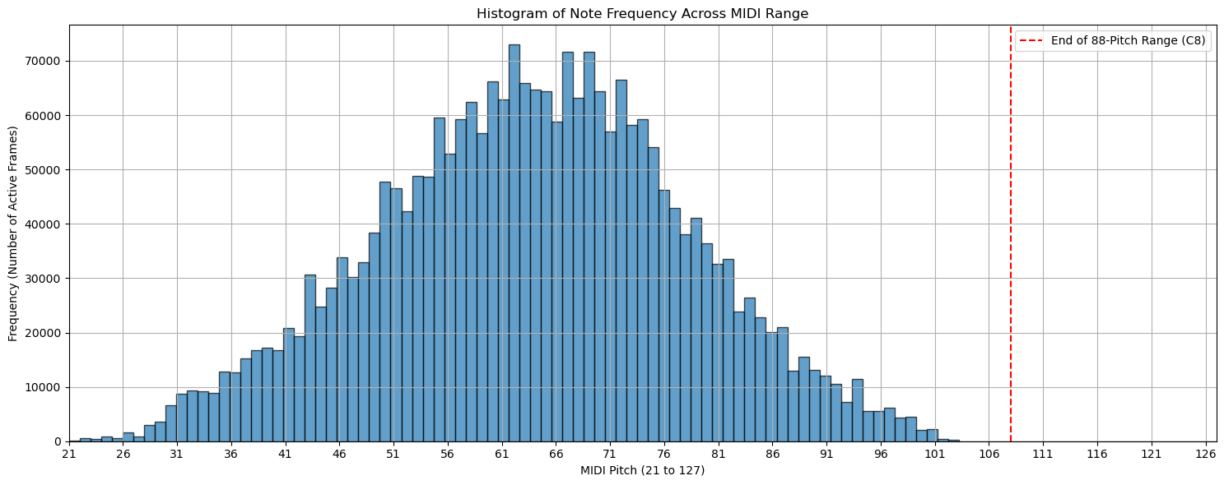
MODULE 4: WHAT WENT WRONG ?
Class Imbalance
The dataset showed a significant imbalance, with many more negative instances (note inactive) than positive instances (note active). This was addressed using focal loss with gamma=1.5, alpha=0.8, and pos_weight=2.0, aiming to focus on hard-to-classify positive examples. However, precision remained low (0.0759 at threshold 0.2), while recall was high (0.5903), leading to an F1 score of 0.1345, indicating many false positives.
No. of Positive Labels : 2.8M
No. of Negative Labels: 39M
Ratio : 1.14

Slide 28
MODULE 4: WHAT WENT WRONG ?
Adjacency Matrix Threshold Issue
Early training attempts with the GCN branch encountered issues, as gradients were absent (indicated by GCN Gradients Present: False), impeding effective learning. To address this, we preprocessed the adjacency matrix by adding self-loops, applying row normalization, and handling NaN values to ensure a valid graph structure. However, this introduced a trade-off: aiming for high sparsity (approximately 0.95) reduced the number of edges, limiting the graph's connectivity, while increasing the number of edges to enhance connectivity conversely reduced sparsity, making it difficult to strike a balance. Unlike the base paper's suggested 0.7 threshold for edge selection, we found it challenging to adopt this cutoff due to the conflicting demands of sparsity and edge density. Despite these adjustments, GCN gradients remained absent in later runs, suggesting deeper integration issues within the model.
Current Threshold : 0.18
Total No. of Nodes: 88
Total no. of Edges: 223
Sparsity : 0.9424
Base Paper Threshold : 0.7
Total No. fo Nodes: 88
Total No. of Edges: 0
Sparsity: 1.0

Slide 29
MODULE 4: WHAT WENT WRONG ?
High Recall and Low Precision
The model consistently showed high recall (0.5903 at threshold 0.2) but low precision (0.0759), suggesting over-sensitivity and many false positives. This was addressed by optimizing the threshold (found optimal at 0.2) and exploring post-processing techniques, though note-level metrics remained zero, indicating challenges in converting frame-level predictions to note events.

Slide 30
MODULE 4: WHAT WENT WRONG ?
GCN Gradient Flow Absence
GCN gradient flow is not enabled, resulting in negligible or absent gradients during training.
Vanishing Gradients: Deep GCN layers with normalization (e.g., LayerNorm) may scale gradients too small.
Small GCN Outputs: Initial GCN output scale (W) is too low, diminishing its contribution to the loss.
Residual Connection Issues: Improper residual connections may suppress GCN updates.
Potential Solutions:
Adjust LayerNorm with a higher epsilon or skip normalization for early layers.
Increase GCN output scale (e.g., higher initial scale value or trainable scaling factor).
Enhance residual connections with skip weights or remove for better gradient propagation.
Impact:
GCN fails to learn meaningful graph representations (e.g., pitch relationships).
Learning shifts to CNN-LSTM, underutilizing GCN’s graph-based insights.
Leads to suboptimal model performance.

Slide 31
MODULE 5: DEPLOYMENT
Web Hosting
Framework
A django project was created to serve as the backend for this project.
HTML5/CSS and JavaScript were utilised to implement the required front-end aspects of the web-application.
File Transfer & Authentication
To facilitate the ease in processing the files, a sessions token has been implemented for each incoming client session in django duly serving the purpose of authentication.
Basic HTTP is utilised to transfer audio files from client to server and the output file from server to client.
Hosting
For development and testing, the project was hosted locally to facilitate quick responses and instant error corrections.
For production, the Django project was tunneled through an ngrok server to make it publicly accessible across all networks via the provided URL.

Slide 32
MODULE 5: DEPLOYMENT
Lilypond
Text-Based Input:
Uses a plain-text language to describe musical sheet scores.
Automatic Engraving:
Converts input into beautifully formatted, publication-quality sheet music with sophisticated typesetting algorithms.
Customization and Precision:
Offers fine control over spacing, layout, and stylistic choices, allowing specific musical traditions.

Slide 33
REFERENCES
Xiao, Z., Chen, X., & Zhou, L. (2023). Polyphonic piano transcription based on graph convolutional network. Signal Processing, 212, 109134.
Edwards, D., Dixon, S., Benetos, E., Maezawa, A., & Kusaka, Y. (2024). A Data-Driven Analysis of Robust Automatic Piano Transcription. IEEE Signal Processing Letters.
Saputra, F., Namyu, U. G., Vincent, D. S., & Gema, A. P. (2021). Automatic piano sheet music transcription with machine learning. Journal of Computer Science, 17(3), 178-187.
Guo, R., & Zhu, Y. (2025). Research on the Recognition of Piano-Playing Notes by a Music Transcription Algorithm. Journal of Advanced Computational Intelligence and Intelligent Informatics, 29(1), 152-157.
de la Fuente, C., Valero-Mas, J. J., Castellanos, F. J., & Calvo-Zaragoza, J. (2022). Multimodal image and audio music transcription. International Journal of Multimedia Information Retrieval, 11(1), 77-84.
Wan, Y., Wang, X., Zhou, R., & Yan, Y. (2015). Automatic piano music transcription using audio‐visual features. Chinese Journal of Electronics, 24(3), 596-603.

Slide 34


